Slide 1


Industry Research
How Might We: How might we enable creators to make more engaging content faster for a wider audience than they already do?
HMW Company: Audible
Teammates: Rei Chen (rc884), Sriya Challa (sc2677), Ruoqi Hua (rh693), Kazim Jafri (khj23), Maxi De Rito (mnd47)
Industries Researched: Content Creators Tools (Audio, Video and other)

Slide 2


PLAYERS
VIDEO CONTENT

Slide 3






Incumbents
Premiere Pro (Adobe): offers tools such as text-based editing, audio transcription, AI assisted tools, and a generally simple workflow.
After Effects (Adobe): focuses particularly on adding special effects and animations to existing content at industry standards.
Final Cut Pro (Apple): video editing software specifically for Apple devices. It is a all-around including audio editing, color grading, and depth of field editing.
Video Editor (Microsoft): free video editing software for Windows devices. It offers basic features for creating and editing videos, such as trimming, cutting, and adding titles.
VideoStudio (Corel): video editing software for Windows devices. It offers a variety of features for creating and editing videos, including motion tracking, chroma key, and 360-degree video editing.

Slide 4




Challengers
Canva: Offers a variety of templates and features for creating visually appealing videos.
Vimeo: Video hosting and sharing platform that allows users to host and share videos, and then collaborate with others on videos.
Loom: Video recording and sharing platform that allows users to record videos of their screen and webcam, and then share them easily.
Riverside.fm: Cloud-based audio and video recording platform that allows users to record high-quality audio and video calls, and then share them easily.

Slide 5





Digital Challengers
LumaFusion: Go-to choice for professionals who demand top-notch video editing while on the move, exclusive to the iOS ecosystem.
Frame.io: Cloud-based platform that allow users to engage in real-time video reviews and provide feedback. Indispensable tool for video professionals and content creators working remotely.
Descript: Cloud-based video editing platform that uses artificial intelligence to make video editing easier. It can automatically transcribe videos, remove background noise, and add music and effects.
Veed.io: Cloud-based video editing platform that offers a variety of features for creating and editing videos, including subtitles, annotations, and screen recording.
Kapwing: Cloud-based video editing platform that offers a variety of features for creating and editing videos that are optimized for social media platforms.

Slide 6
PLAYERS
AUDIO CONTENT

Slide 7




Incumbents
Audition (Adobe): professional audio editing software that offers a wide range of features for editing, mixing, and mastering audio.
Audacity: free and open-source audio editing software. Popular choice for podcasters and other audio content creators.
Logic Pro (Apple): digital audio workstation (DAW) for macOS. Popular choice for music producers and other audio professionals.
Pro Tools: DAW for Windows and macOS. Popular choice for audio professionals in the film, television, and music industries.

Slide 8



Challengers
Hindenburg: podcasting-focused DAW for macOS. It offers a streamlined interface and a variety of features for podcasters.
Alitu: cloud-based audio editing platform that makes it easy to create podcasts. It offers a variety of features for recording, editing, and publishing podcasts.
Headliner: podcast editing and publishing platform that allows users to edit their podcasts, add transcripts, and publish their podcasts to podcast directories.

Slide 9


Digital Challengers
Descript: Cloud-based audio editing platform that uses artificial intelligence to make audio editing easier. It can automatically transcribe audio, remove background noise, and add music and effects.
Otter.ai: AI-powered transcription platform that automatically transcribe audio and video files, and then generate subtitles or transcripts.
Speechify: AI-powered text-to-speech platform. It can convert text into audio, and then read the audio back to you.

Slide 10
PLAYERS
IMAGE CONTENT

Slide 11




Incumbents
Photoshop (Adobe): professional image editing software. It is the industry standard for image editing and offers a wide range of features for creating, editing, and manipulating images.
Lightroom (Adobe): photo management and editing software. Designed for photographers to organize, edit, and share their photos.
GIMP: free and open-source image editing software. Popular choice for hobbyists and budget-minded users.
Affinity Photo: paid image editing software. It is a popular choice for users who are looking for an alternative to Adobe Photoshop.

Slide 12



Challengers
Canva: cloud-based graphic design platform that can also be used for image editing. It offers a variety of templates and features for creating visually appealing images.
VSCO: photo editing app for mobile devices that offers a variety of filters and editing tools for creating stylized images.
Snapseed (Google): photo editing app for mobile devices that offers a variety of tools for editing and enhancing images.
Picsart: photo editing app for mobile devices. It offers tools for editing and enhancing images, as well as the ability to create collages and memes.

Slide 13





Digital Challengers
DALL-E 2 (OpenAI): large language model (LLM) chatbot that can generate realistic images from text descriptions.
Imagen (Google): LLM that can generate realistic images from text descriptions.
Parti (Nvidia): LLM chatbot that can generate realistic images from text descriptions.
Midjourney: LLM chatbot that can generate realistic images from text descriptions.
Craiyon (Wombo): LLM chatbot that can generate realistic images from text descriptions.

Slide 14
PLAYERS
TEXT CONTENT

Slide 15


Incumbents
Microsoft Word: word processing software. It is the industry standard for word processing and offers a wide range of features for creating, editing, and formatting text documents.
InDesign (Adobe): desktop publishing software. It is designed for creating and designing complex documents, such as magazines, brochures, and books.

Slide 16


Challengers
Google Docs: cloud-based word processing software. It is a popular choice for users who want to collaborate on documents online.
Canva: cloud-based graphic design platform that can also be used for text editing. It offers a variety of templates and features for creating visually appealing text documents.
Grammarly: AI-powered writing assistant. It can help users to improve their grammar, spelling, and punctuation.

Slide 17




Digital Challengers
ChatGPT (OpenAi): It is one of the most powerful language models ever created, and it can generate text, translate languages, write different kinds of creative content, and answer your questions in an informative way. Is still under development, but it has the potential to revolutionize the way we interact with computers.
Jasper (AppSumo): LLM chatbot that can generate text, translate languages, write different kinds of creative content, and answer your questions in an informative way.
LaMDA (Google): is similar to GPT-3 in terms of its capabilities, but it is specifically designed to be informative and comprehensive. LaMDA can answer your questions in an informative way, even if they are open-ended, challenging, or strange.
Jarvis: LLM chatbot developed similar to GPT and LaMDA in terms of its capabilities, but it is specifically designed to be used for business purposes.

Slide 18
ECOSYSTEM

Slide 19

PLAYERS: Ecosystem
Suppliers:
Hardware and software suppliers providing the necessary tools for content creation, such as Adobe, Apple, Microsoft, and camera/equipment manufacturers.
Service Providers:
Cloud service providers like Amazon Web Services (AWS) or Microsoft Azure for storage and processing needs.
Streaming platforms for hosting and delivering content, such as YouTube or Vimeo.
Partners:
Content creators: These are the people who use the content creator tools to create content.
Content platforms: These can include social media platforms like Facebook, Instagram or content management systems like WordPress etc.
Channel Partners:
Resellers and distributors who sell content creation software or equipment, like Best Buy or B&H Photo Video.
Investors:
Strategic Investors like companies within the media and entertainment industry.

Slide 20

PROCESSES

Slide 21
General Process
Content Research
(Planning)
Content Creation (Editing)
Performance (Analyzing)
Converting Ideas into Scripts, Scheduling Content Release Times, Deciding if an Ideas is Worth Creating and Pursuing
Take Recorded Content and Edit It into both:
Specific Form for Platform
Specific Form for Algorithm
Add Special Effects, Add Transcriptions and Closed Captioning, Add Animations and Transitions, Modify Manuscripts, Finalize All Created Content
Review Analytics, Read Comments, Read Articles, Generally Review All Feedback, Compare Content Performance to Self and Others on the Platform.
Take the Feedback and Influence the Research Stage to Adapt Content for What the Audience (and Algorithm) Want
Content Research (Researching)
Content Creation (Creating)
Distribution
(Publishing)
Finding New Ideas, Researching Potential Future Content, Determining How to Produce Content, and Taking Feedback to Adapt Future Content to Perform Better
Record Scripted or Unscripted Content, Practice Acting Out Scripts, Write Out Books or Papers, Record Audio, Livestream, or Otherwise Perform Planned Content
Publish Content to Primary Platform, Modify Content for Secondary Platforms, Promote Content to Promotional Platforms, Monetize Content, Open Up for Feedback, Collaborate to Promote

Slide 22
General Process // Industry Examples
Content Research Stage
Content Creation Stage
Generally, most industries tend to stick to a similar pattern of content research. Starting with feedback from prior content and general insight into where algorithms are or what audiences are looking for, creators use tools from Google and Microsoft Office to organize their research and plan when to work on what type of content. If collaboration is required, they use tools like Slack, Zoom, and other email platforms. To share content, OneDrive, Google Drive, and Dropbox are generally popular tools used.
Podcasting Example: Record podcast using Zoom and recording equipment (microphones, filters, echo reducers, etc), transcribe using Zoom Captioning or Adobe transcribers, edit using Adobe Premiere, and create thumbnails using Canva or Photoshop.
Video Creation Example: Record content via livestreaming or through a private recording session using professional or common hardware (cameras, lighting, etc), create captions using Sonix, edit using Final Cut Pro, and add special effects using Adobe After Effects.
Written Media Example: Record or type content using text-editors or speech-to-text devices, revise manuscripts through editors and professionals, and find potential covers
Publishing
Generally, most industries follow the general pattern of publishing to their primary platform. They may need the assistance of publishing companies or approval from managers and content advisors. They then monetize content using built-in tools (platform subscriptions, ad revenue, sales) or external tools (sponsorships, partnerships). The second step is to usually adapt the primary content into forms that could be published to secondary audiences, such as posting a YouTube video notification to your Instagram story, re-editing your livestream or podcast into bite-sized clips for TikTok, or advertising your content on text platforms like Twitter.
Reviews
Most industry tools have built-in analytics options to pure statistics to see how engaging their content is, how long audiences stay tuned in, how fast they get through content, and demographics. Some platforms may also support built-in comments for qualitative feedback. Additionally, outside tools may be worth reviewing, such as critic articles, external review websites, or external statistic tracking platforms such as VidIQ or other user-designed trackers. Use this when researching new future content.

Slide 23
CONTENT CREATION TOOLS CLOCKSPEED
EMERGING TECH
SOFTWARE RELEASE CYCLES
HARDWARE INNOVATIONS
COMPETITION
MARKET TRENDS
USER FEEDBACK
The adoption of emerging technologies, such as AI and machine can affect cycle times. Integrating these technologies into content creation tools may require research and development efforts that extend cycle times.
Many companies in this industry release regular updates and new versions of their software. The cycle time for software updates can range from a few months to a year or more. Major updates may have longer cycle times.
Advances in hardware technologies can influence the cycle time in this industry. As hardware capabilities improve, software developers may need time to adapt their tools to take advantage of these advancements.
Competition among software providers can lead to shorter cycle times as companies strive to release new features and improvements faster to stay ahead of their rivals.
Market trends and consumer demands can also impact cycle times. For example, if there's a sudden surge in demand for specific formats (e.g., VR content), companies may prioritize development in that area and adjust their cycle times accordingly.
Responding to user feedback and addressing software bugs can introduce shorter cycle times for minor updates and patches.

Slide 24

PROFITS

Slide 25

Business Model
Subscription: users pay a monthly or yearly fee to access the tool.
Freemium: free version of the tool with limited features, and users can pay for a premium version to unlock more features.
Pay-per-use: charges users for each time they use the tool.
Advertising: generates revenue by displaying ads to users. Popular model for tools that are used by a large number of users.
Revenue Streams
Subscription fees: This is the most common revenue stream for content creator tools.
Advertising revenue: This is a popular revenue stream for tools that are used by a large number of users.
Selling premium features: Some tools offer premium features that users can pay for.
Selling add-ons: Some tools offer add-ons that users can pay for.
Selling data: Some tools sell data about their users to third parties.

Slide 26
Costs (fixed)
Development costs: This includes the cost of developing the tool and its features.
Marketing costs: This includes the cost of marketing the tool to potential users.
Customer support costs: This includes the cost of providing customer support to users.
Costs (variable)
Bandwidth costs: This includes the cost of transferring data to and from users.
Storage costs: This includes the cost of storing data about users.
Payment processing fees: This includes the fees charged by payment processors.
Risk Bearing
Technology risk: This is the risk that the tool may not work as expected or that it may be vulnerable to security breaches.
Competition risk: This is the risk that other companies will develop better tools that compete with the tool.
Regulation risk: This is the risk that governments may regulate the tool in a way that makes it less profitable.

Slide 27

TECHNOLOGY RESEARCH

Slide 28

Technology Research
Activity: Analytics
Enabling Technology: Analytics platforms
Status: Commercialized
Key Metrics:
Downloads/Streams: Measure how many times a content is downloaded or streamed.
User Demographics: Understand the age, gender, location and interests of users.
Engagement: Measure how long users stay engaged during a content.

Slide 29

Technology Research
Activity: Personalized Narration / Translation
Enabling Technology: AI-Driven
Status: Unsolved
Key Metrics:
Narration quality: Measure how well the AI-generated narration aligns with human narration quality.
Translation accuracy: Measure how accurately the AI translates spoken content.
Personalization accuracy: Assess how accurately the AI can adapt the narration style to match individual user preferences.
Engagement increase: Determine if personalized narration leads to longer engagement times and increased user satisfaction.
Feedback: Implement a system where user feedback helps improve the AI's personalization accuracy over time.

Slide 30

Technology Research
Activity: Automatic Audio Content Summarization
Enabling Technology: AI-Driven
Status: Unsolved
Key Metrics:
Summarization accuracy: Measure how effectively the AI can accurately summarize podcast episodes.
User engagement: Analyze whether summarized content increases user engagement and encourages them to listen to full episodes.
Key takeaways: Assess if the generated summaries effectively capture the main points and highlights of the episode.
Time efficiency: Determine the time required for the AI to generate summaries relative to the episode length.

Slide 31

DIGITALIZATION AUDIT

Slide 32

Content Research Stage (Researching)
ANALYZE: Researching primarily involves using digital analytic tools to collect and analyze data to identify trends and topic ideas, emphasizing the application of data analysis and insights.
Keyword Analysis
Expertly analyze keywords to find the most searched and relevant content.
Competitor Analysis
Investigating competitors' content using online search engines.
Trend Analysis
Analyze audience interests and trends to produce relevant and compelling content.

Slide 33

Content Research Stage (Planning)
COMMUNICATE AND SHARE: Planning involves the use of digital tools for setting up calendars, monitoring audience feedback, and enhancing team collaboration, which are all focused on communication and sharing of information and plans among teams and stakeholders.
Editorial Calendar
Set up a digital calendar to plan and organize content creation based on different campaigns and promotions.
Social Media Listening
Collect and monitor audience feedback and sentiments to compile a more informed digital content strategy.
Team Collaboration
Use digital tools to foster better collaboration between teams, who may be remotely located.

Slide 34

Content Creation Stage (Creating)
DIGITAL DATA COLLECTION: Creating utilizes digital tools to enhance and expedite the content creation process, but it still requires human intervention and creativity in certain aspects, rather than being fully automated. This level emphasizes digital data collection, encompassing the use of digital tools to assist in the manual content creation process, without completely replacing human involvement.
Streamlined Content Creation
Use digital tools to speed up the content creation process without sacrificing quality.
Dynamic Content Creation
Create dynamic content, incorporating advanced technologies like augmented reality, virtual reality, and interactive content.

Slide 35

Content Creation Stage (Editing)
AUTOMATE: Editing involves extensive use of advanced digital tools and automation techniques, including adding in-video links, automated quality checks, automated coloring, and AI-powered cropping, emphasizing automation and efficiency in the editing stage.
In-Video Links
Use advances tools to add in-video links to other content to keep the viewer engaged.
Automated Quality Checks
Automate proofreading and grammar checking to enhance the quality of content.
Automated Coloring
Use automated coloring software to enhance the appeal and quality of videos and images.
AI-Powered Crop
Use AI cropping technology to optimize images and videos for different screen sizes, devices, and platforms.

Slide 36

Content Distribution (Publishing)
ANALYZE: Publishing involves activities such as modifying content for different platforms, promoting content across various media outlets, adapting to different platform styles and algorithms, and monetizing through multiple channels. It requires in-depth analysis and strategic planning to ensure optimal results.
Social Media Promotion
Utilizing digital tools and advertising platforms like Facebook Ads or Google Ads to promote published content, expanding the audience reach and increasing exposure.
Cross-Platform Content Adaptation
Modifying content to suit different digital platforms, such as adapting videos for TikTok (portrait mode) and YouTube (landscape mode), to meet the expectations and style requirements of various platforms.

Slide 37
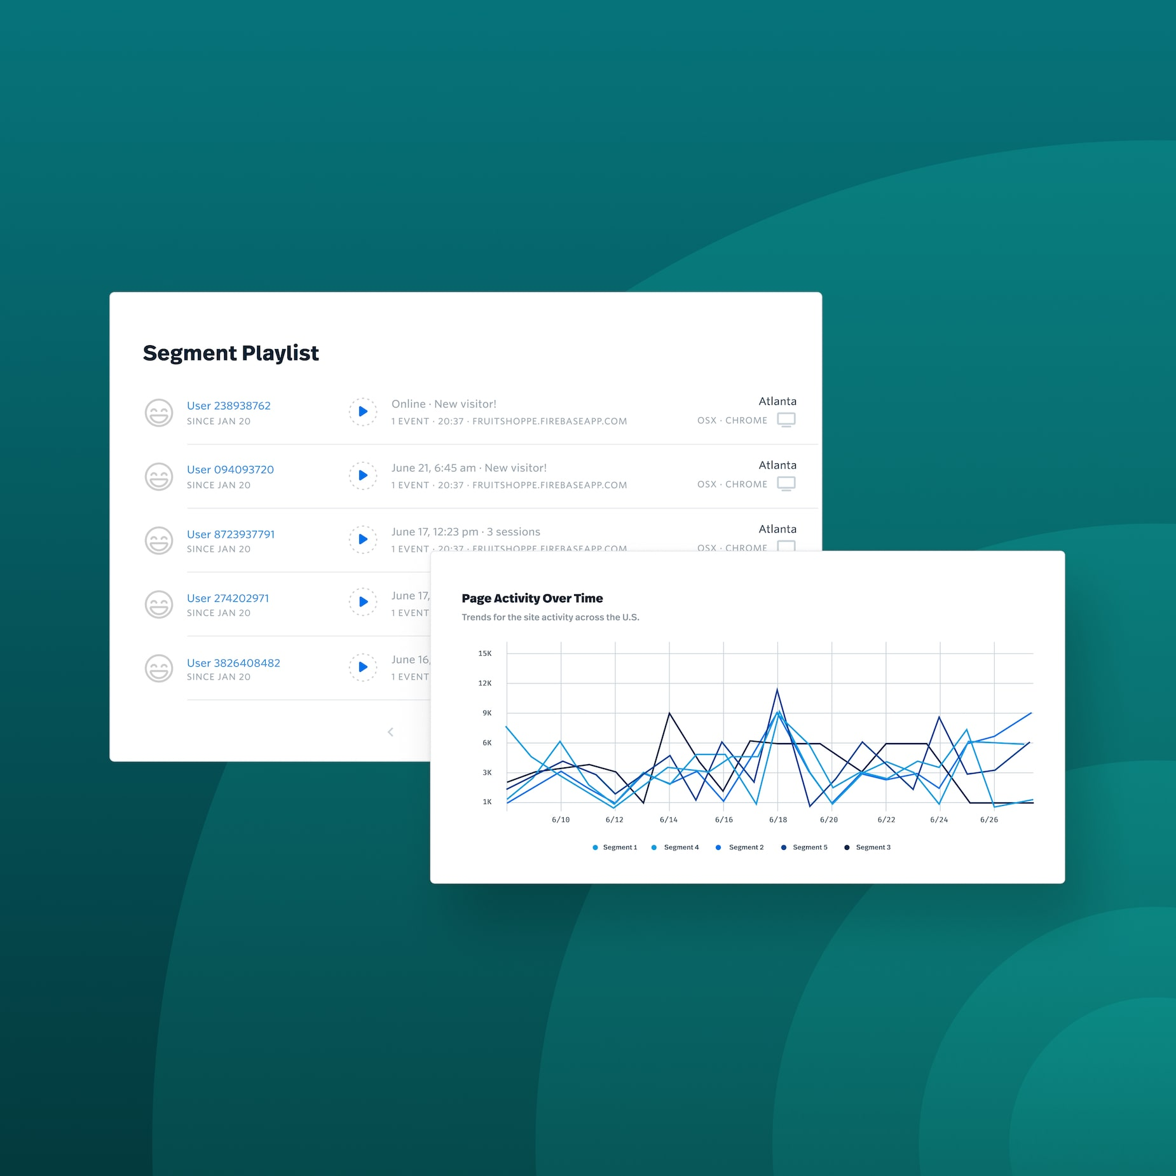
Content Performance (Analysis)
ANALYZE: Reviews involve the analysis of various data and feedback, including research analysis, sentiment analysis, and tracking and analysis of customer engagement. It emphasizes in-depth analysis of this digital data to make targeted improvements in the content creation and research stages.
Sentiment Analysis
Use sentiment analysis tools to understand customer sentiment towards the product or service.
Engagement Tracking
Use digital tools to track and analyze customer engagement and interaction with the content.

Slide 38
COLLECTIVE INTERVIEW SUMMARY

Slide 39
Total Amount of Interviews: 12 Completed ; Total Time Duration of Interviews: 518 Minutes
Amount of Interviewees Categorized as:
Potential Customers: 10
Potential Users: 10
Stakeholders (Experts, Service Providers, Suppliers, etc): 2
Other (Lawyer): 1
What have been the most successful ways to source interviewees?
The best way we've found to find people for interviews has been by using our contacts from past jobs and other networks. We reached out to people whose work we had been following over the past few years. Examples being people we met at conferences or whose content we have been following on social media for a long time. Having knowledge about their work made it easier for us to communicate with them better and the interviews were really insightful and inspiring.
What have been the least successful ways to source interviewees?
The least successful approaches for sourcing interviewees have included direct private messaging to show's official accounts, which often yield minimal response. On the other hand, engaging through personal accounts increases the likelihood of a reply, albeit with fewer occurrences. Although both these interactions (messaging official and personal accounts) offered valuable insights, it's essential to acknowledge that their impact and success was relatively modest compared to our conventional methodologies.

Slide 40
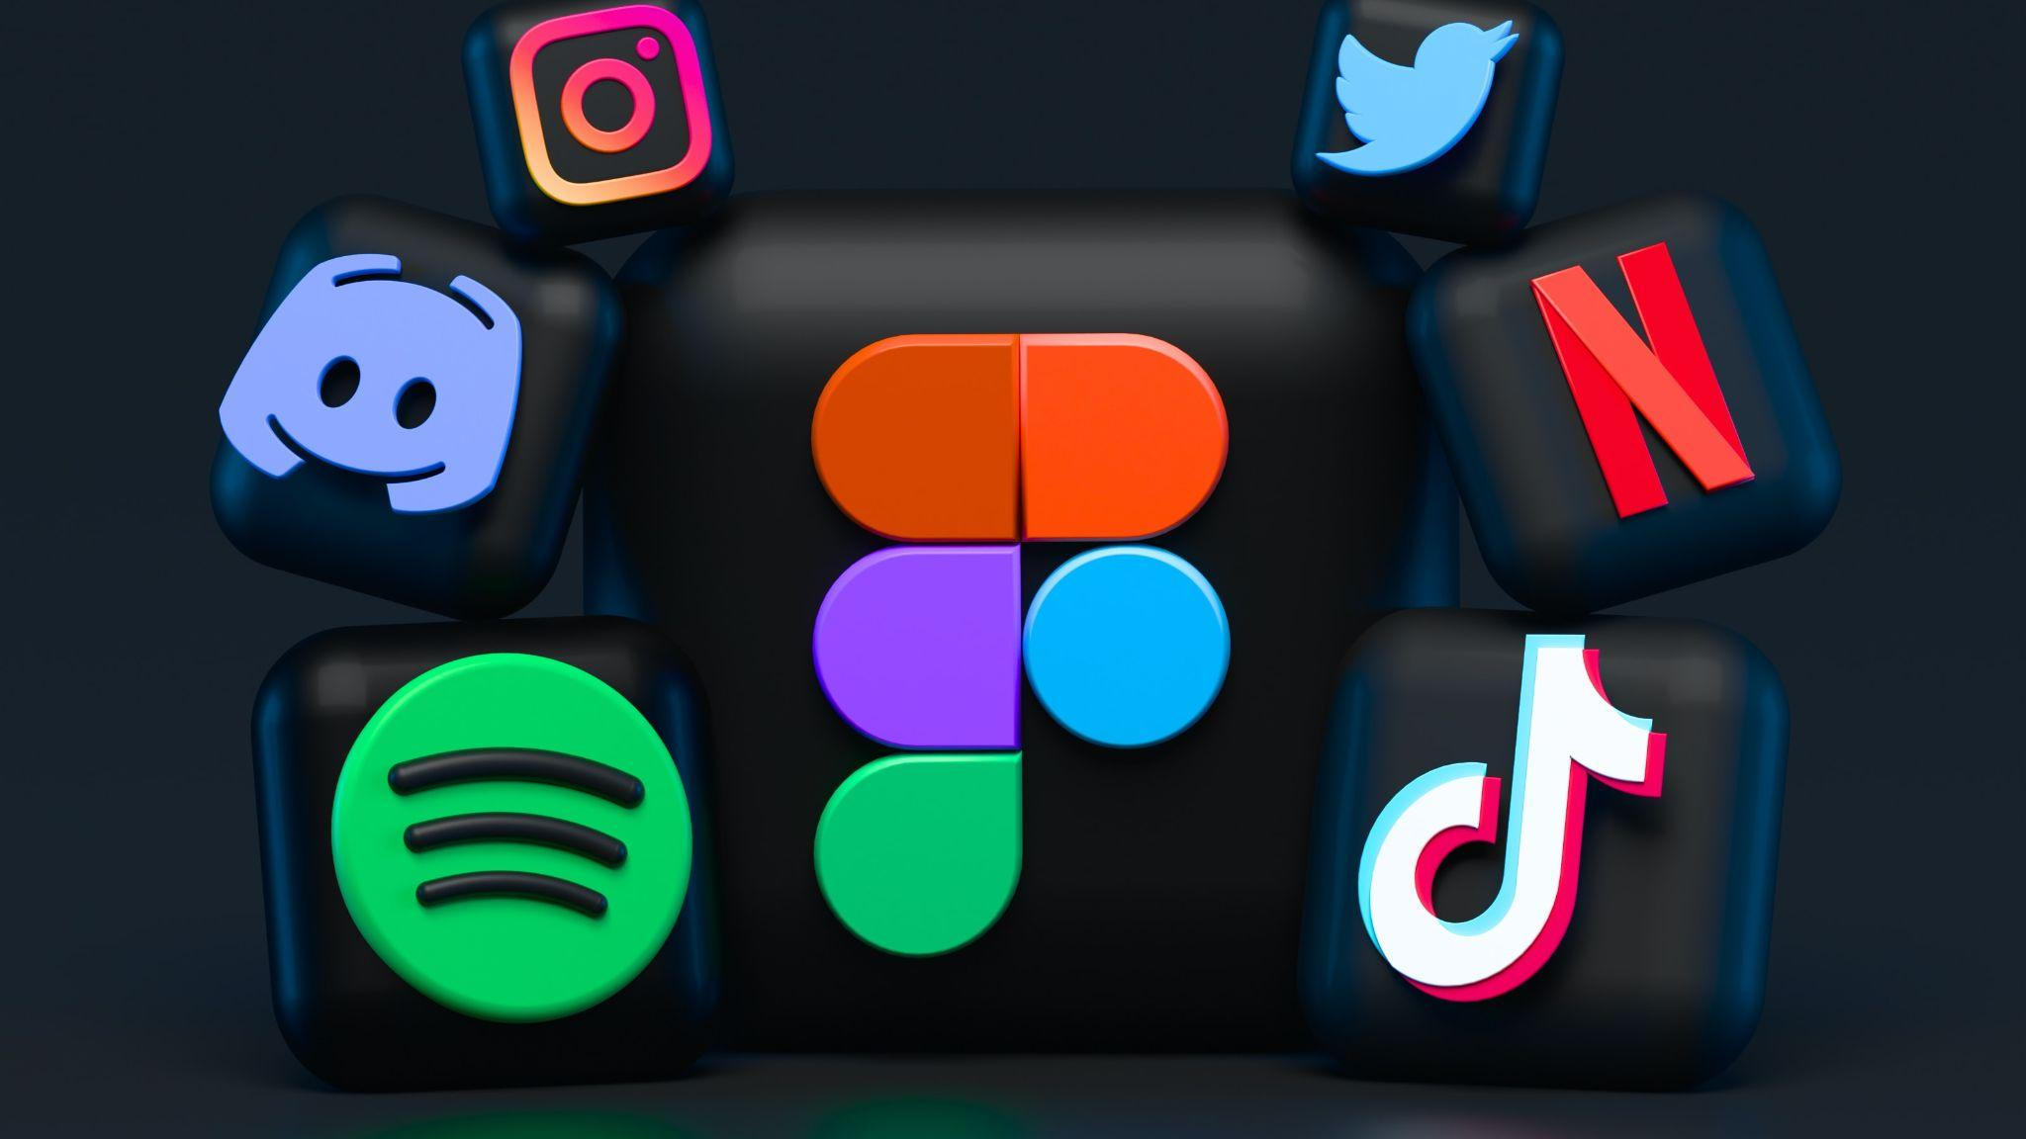
RICH PICTURE

Slide 41
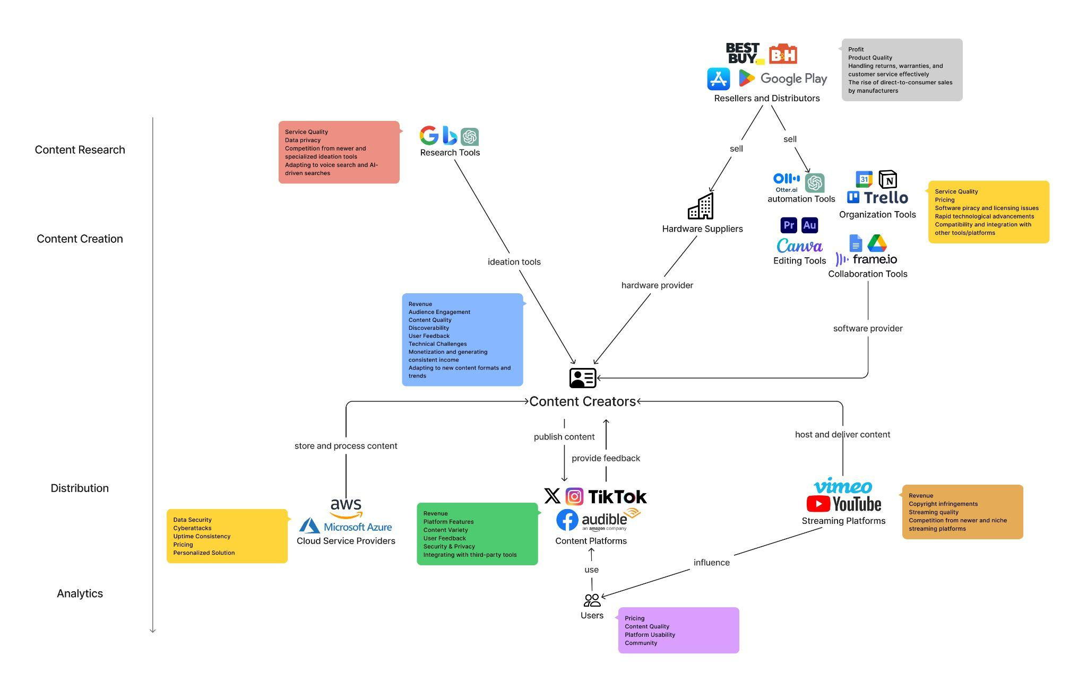
Full image: Link to full image

Slide 42
DECOMPOSING HMW INTO THEMES/TOPICS
How might we enable creators to make more engaging content faster for a wider audience than they already do?
Themes/Topics:
Creators struggle with the time-intensive nature of these tasks, which hinders their ability to produce content quickly.
Creators often face challenges in balancing available resources with their content format decisions (budget limitations, cost of tools and services, etc.)
Creators often face challenges in promoting their work and engaging with their audience across different platforms.
Creators face various technical challenges that impact the efficiency and quality of content creation.
Creators encounter various complexities in the non-linear content creation process.

Slide 43
APPENDIX
Audiobook and podcasting industry analysis

Slide 44
PLAYERS
PODCASTING INDUSTRY

Slide 45
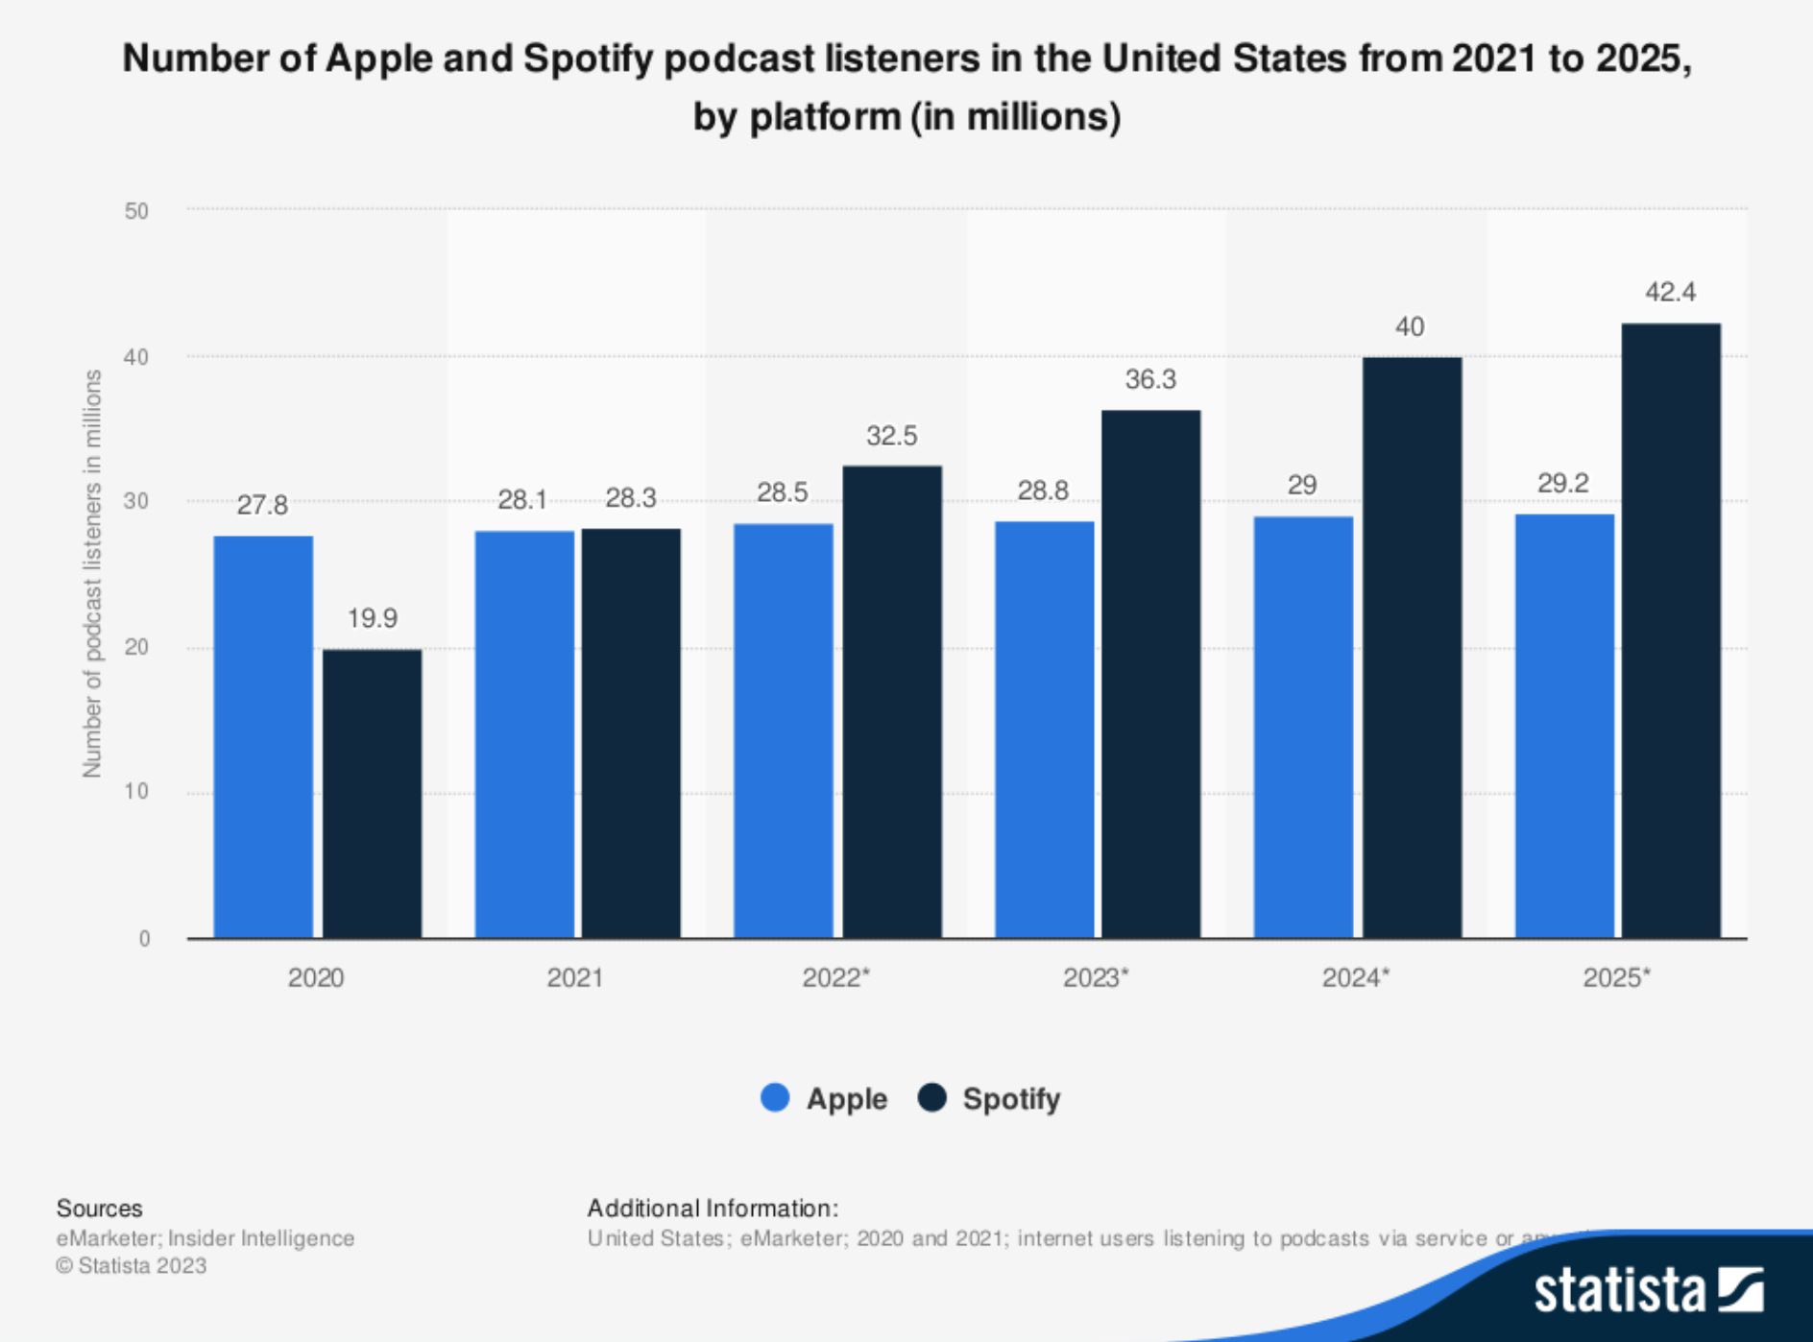
Incumbents
Apple Podcasts (formerly iTunes): As one of the pioneers in podcast distribution, continues to be a major distribution channel for podcasts.
Spotify: Has made substantial investments in the podcasting space, both by acquiring podcast networks and developing exclusive content. It aims to become hub for audio entertainment.
Google Podcasts: Seeks to leverage its search and discovery capabilities to make podcasts more accessible to a wider audience.
eMarketer: Insider Intelligence Statista 2023

Slide 46

Challengers
Stitcher (acquired by SiriusXM): It connects all parts of the podcast universe (creators, listeners and advertisers) and offers a range of podcasts across various genres.
Anchor: Offers a user-friendly platform with tools that simplify podcast creation, distribution, and monetization. Record and edit episodes on the go. Empowers individuals who might not have extensive technical knowledge to enter the podcasting space, contributing to the democratization of podcast content creation.
Pocket Casts: Emphasizes advanced features such as customizable playlists, variable playback speeds, and cross-device syncing. Targets listeners who seek more control over their podcast listening experience.
Podbean: Provides podcast hosting, monetization, and listener engagement solutions. Its platform focuses on empowering podcasters to grow their audiences and generate revenue.

Slide 47
PLAYERS
AUDIOBOOK INDUSTRY

Slide 48

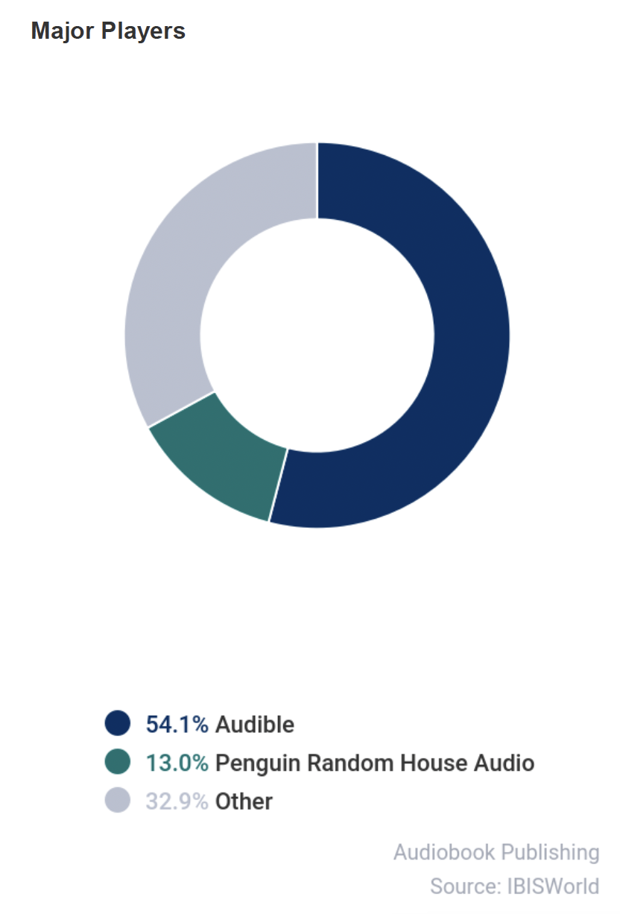
Incumbents
Audible: Audible is a dominant player in the audiobook market, offering a vast library of audiobooks across genres.
Penguin Random House Audio: diverse collection of titles across genres, supported by the publishing prowess of Penguin Random House and a commitment to top-notch production quality.
Google Play Books: Google's audiobook platform competes by integrating with its ecosystem of devices and services.

Slide 49

Challengers
Libro.fm: Differentiates itself by partnering with independent bookstores to offer audiobooks and support local businesses.
Kobo Audiobooks: Known for its e-readers, also offers an audiobook platform as part of its ecosystem.
Scribd: Offers a subscription model that allows users access to both ebooks and audiobooks for a monthly fee. Challenges the traditional pay-per-title model and encourages more exploration of content.
Chirp: Focuses on limited-time deals for audiobooks, appealing to price-conscious consumers. It introduces a sense of urgency to audiobook purchasing.
Audiobooks.com: Offers a subscription model specifically tailored to audiobook enthusiasts. Subscribers gain access to a rotating library of titles each month. Alternative for users who prioritize access over ownership.

Slide 50
PLAYERS
SOCIAL MEDIA INDUSTRY

Slide 51

Incumbents
YouTube: A giant in the online video sharing space, enabling content creators to reach a global audience.
Facebook/Instagram: These platforms are major players in social media, enabling creators to share video content and engage with a wide user base.
TikTok: Known for short-form videos, has rapidly gained popularity, especially among younger audiences.
Snapchat: Offers a unique platform for sharing short-lived multimedia content, including videos and images.
X (formerly Twitter): While primarily known for text-based content, also supports video sharing and live streaming.

Slide 52

Challengers
Twitch: Originally for gamers, now includes diverse content like art, music and talk shows, and disrupted the way creators interact in real time with their communities.
Vimeo: Positioned itself as a platform for creative and professional video content, focusing on quality over quantity. It provides advanced tools for video creators.
Parler: It marketed itself as a free speech-focused alternative to mainstream social media platforms, attracting users seeking less moderation.

Slide 53
PROCESSES

Slide 54
PODCASTING
2. Publishing
4. Promotion
Uploading episodes to podcast hosting platform
Adding metadata (title, description, tags)
Setting release schedule
Sharing on social media
Collaborating with podcast networks
Guest appearances on other podcasts
1. Content Creation
3. Distribution
5. Monetization
Researching topics
Writing scripts
Recording audio
Editing and enhancing audio quality
Platforms distribute episodes to podcast directories (Apple Podcasts, Spotify, etc.)
Users subscribe and listen to episodes
Advertising and sponsorships
Listener donations or subscriptions
Premium content for paid subscribers

Slide 55
PODCASTING CLOCKSPEED
CONTENT CREATION
TECHNOLOGY
INNOVATION
Podcast episodes are often released on a regular schedule, such as daily, weekly or bi-weekly.
New tools and platforms for podcasting can emerge relatively quickly due to the accessibility of recording and editing equipment/software.
Innovations can come in the form of new storytelling techniques, formats and approaches to engage listeners.

Slide 56
AUDIOBOOKS
2. Production
4. Promotion
Hiring narrators and producers
Recording and editing audio
Adding sound effects and music (if applicable)
Reviews and ratings
Promotions on social media and book-related platforms
1. Content Selection
3. Distribution
5. Monetization
Choosing books to produce as audiobooks
Negotiating rights with authors/publishers
Uploading audiobooks to platforms (Audible)
Users purchase and download audiobooks
Audiobook sales
Subscription models (if applicable)

Slide 57
AUDIOBOOK CLOCKSPEED
CONTENT CREATION
TECHNOLOGY
INNOVATION
Audiobooks are produced at varying rates, influenced by factors such as book releases.
Improvements in audio recording and distribution technology may have a slightly longer cycle compared to podcasting due to the more complex production process.
Innovations might involve immersive audio experiences, enhanced interactive elements or new business models.

Slide 58
CONTENT PLATFORMS
2. Publishing
4. Monetization
Uploading content to platforms (YouTube, Instagram, etc.)
Adding captions, descriptions, hashtags
Advertising revenue
Sponsorships and collaborations
Paid subscriptions or donations
1. Content Creation
3. Engagement
Producing videos, images, text-based content
Editing and enhancing content
Users like, comment, share, or interact with content
Creators engage with the audience

Slide 59
CONTENT PLATFORMS CLOCKSPEED
CONTENT CREATION
TECHNOLOGY
INNOVATION
The speed of content creation can be rapid, with creators frequently posting new content.
Platform updates and new features can roll out quickly due to the digital nature of these platforms.
Innovations could involve new formats (eg. short-form video, live streaming), content discovery algorithms and monetization strategies.

Slide 60
PROFITS

Slide 61
Podcasting
Business Model
Ad-supported model: Many podcasts are available for free to listeners, supported by advertising revenue.
Subscription/Premium model: Some podcasts offer ad-free episodes, early access or exclusive content to subscribers who pay a monthly fee.
Revenue Streams
Advertising from sponsored episodes (2.2B in US 2023)
Subscription fees for premium content
Costs
Fixed: Podcast production (narration, recording, editing), equipment (microphones, recording software), hosting fees.
Variable: Marketing expenses, guest fees (if applicable)
Risk Bearing
Creators often bear the risk of content creation and audience engagement.
Hosting platforms may bear the risk of server stability and maintenance.

Slide 62

Audiobooks
Business Model
Retail model: Audiobooks are sold individually to consumers, either as digital downloads or physical CDs.
Subscription model: Platforms like Audible offer monthly subscription plans that allow users to access a certain number of audiobooks per month.
Revenue Streams
Audiobook sales revenue - 1.6B annual (Audiobook Industry IBISWorld 2023)
Subscription fees for access to audiobooks
Costs
Fixed: Audiobook production (narration, editing), licensing fees.
Variable: Marketing expenses, distribution costs. (Like book publishers, audiobook publishers devote considerable resources to informing consumers about their products, companies spend an estimated 6.9% of revenue on marketing campaigns in 2023 - Audiobook Publishing IBISWorld)
Risk Bearing
Audiobook producers bear the risk of production quality and appeal to listeners.
Platforms bear the risk of providing a smooth user experience.

Slide 63

Content Platforms
Business Model
Advertising model: Platforms generate revenue through advertisements shown to users.
Freemium/Premium model: Users can access basic features for free, but premium features or content require a subscription or payment.
Revenue Streams
Advertising revenue from ads shown to users
Subscription revenue from premium features or content
Costs
Fixed: Platform development, server maintenance.
Variable: Content storage, streaming costs, content moderation expenses.
Risk Bearing
Creators bear the risk of content creation and audience engagement.
Platforms bear the risk of user engagement, content moderation and maintaining a safe environment.

Slide 64
DIGITALIZATION AUDIT

Slide 65
DIGITALIZATION AUDIT - Podcasting
Content Creation
Digital Data Collection: Use of digital recording equipment, digital notes, online collaboration tools for scriptwriting. Not all aspects of podcast production can be fully automated.
Publishing
Digital Data Collection: Publishing episodes digitally on platforms like Spotify, Apple Podcasts, or hosting them on a website.
Distribution
Analyze: Distribution strategy is based on continuous analysis and adaptation.
Promotion
Analyze: Measuring the effectiveness of different promotion strategies based on online engagement and conversion rates.
Monetization
Analyze: Analyzing subscriber growth, conversion rates, and listener feedback on monetization strategies.

Slide 66
DIGITALIZATION AUDIT - Audiobooks
Content Selection
Analyze: Analyzing sales data and reader feedback to identify popular genres and trends.
Narration and Production
Digital Data Collection: Utilizing digital recording equipment and software for professional narration.
Distribution
Analyze: Distribution involves selecting a clear niche and optimizing content with keywords.
Marketing and Promotion
Analyze: Measuring the effectiveness of different marketing channels through click-through rates, engagement metrics, and sales data.
Monetization
Analyze: Analyzing sales patterns, subscription growth, and user feedback on pricing strategies.

Slide 67
RICH PICTURE

Slide 68
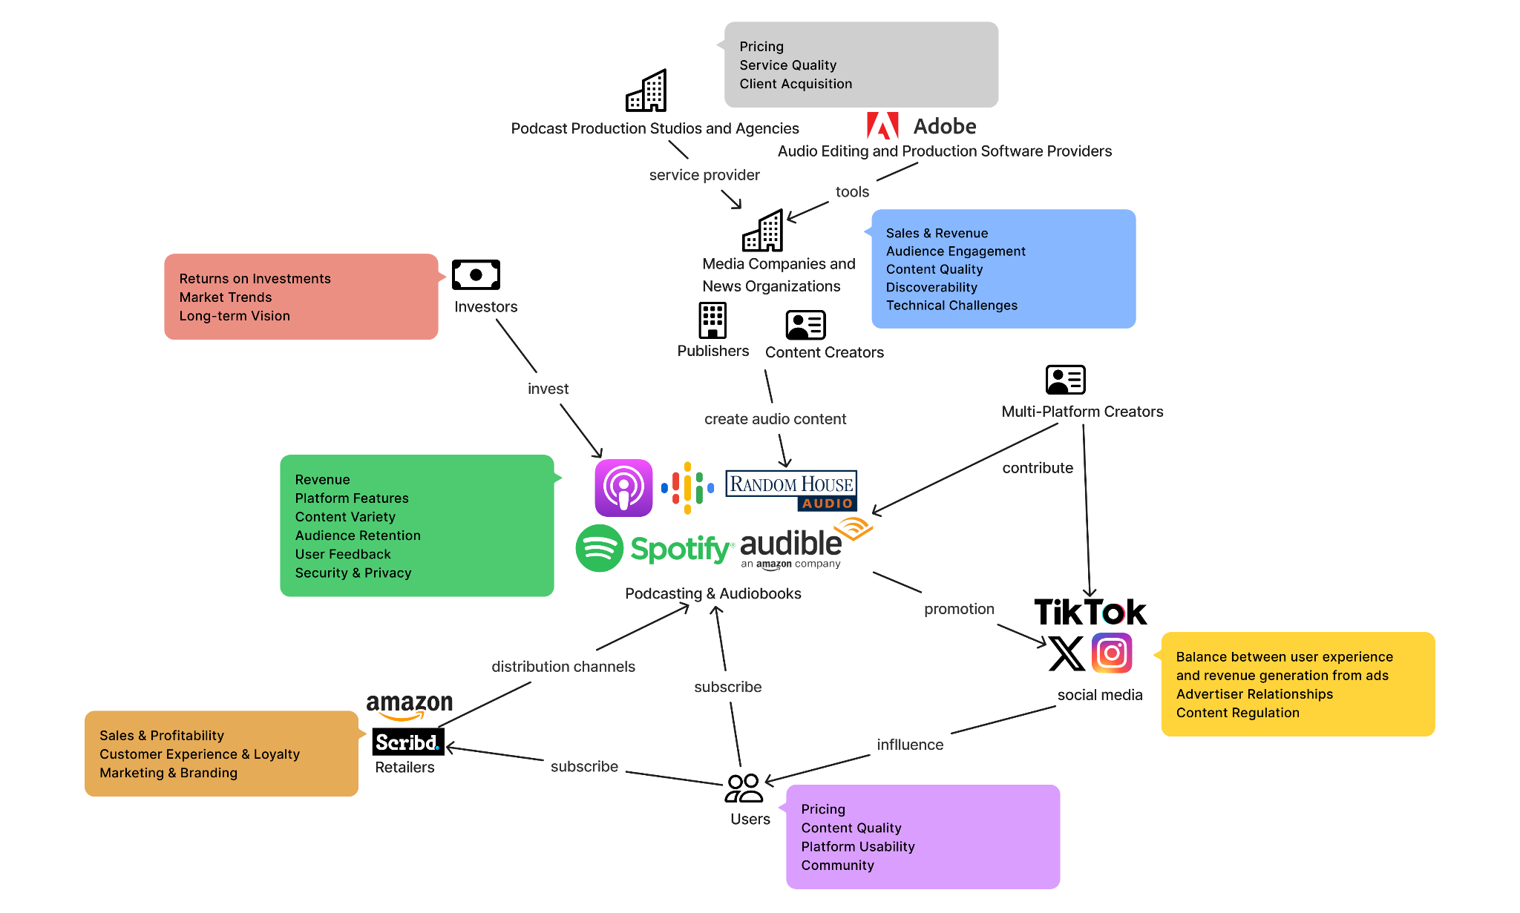
Full image: Link to full image

Slide 69
SOURCES
https://my-ibisworld-com.proxy.library.cornell.edu/search/?q=podcast
https://www-statista-com.proxy.library.cornell.edu/search/?q=podcast&p=1&isRegionPref=840
https://reports.mintel.com/display/1156455/?highlight
https://insights-technavio-com.proxy.library.cornell.edu/index.php?route=product/product&product_id=220956
https://guides.library.cornell.edu/cornelltech/business-research

